Slide 1
3 Interpretation
CPU is also an interpreter, of machine instructions …

Slide 2
Interpreters
Recursive interpreter
  Not primitive instructions (subcommands, sub sub commands, …)
Iterative interpreter
  Primitive instructions (HALT, JUMP, MOVE, …)
TAM interpreter
Notes:
Interpreter – program that executes immediately
Iterative interpretation when instructions are executed one after another and it is suitable when source language instructions are primitive (MOVE, HALT, ADD, SUB, JUMP, …)
Recursive interpretation when instructions (commands) are not primitive (subcommand, sub subcommand, …), each not primitive instruction have sub sets of instructions “trees”.
Recursive+iterative interpreters, “tombstones”
Read (8.2, 8.3;C.1-C.3)
- what is the interpretation?
- differences between iterative and recursive
- examples of interpreters used/can be used in our project
- what is the tombstone?
- example of tombstones in our system?
What is TAM interpreter?
TAM interpreter analyzes the entire source program before executes, here it lose main feature of the interpretation – immediacy. Better alternative use a compiler. That is why is not good idea to use recursive interpreter. (it is slow)

Slide 3
Iterative/Recursive Interpretation
init
fetch
fetch
analyze
analyze
execute
execute
There are
still
instructions?
Notes:
Here are two schemes of interpretation. At the left scheme of iterative interpretation and at the right scheme of recursive interpretation.
Iterative interpretation: fetch the instruction, when analyze it if instruction correct (if it wrong it wont execute it) it executes it.
Recursive interpretation: fetch the all tree of instructions (AST) analyze them all, and when execute all. It not feature of interpreter because it lost immediacy feature.

Slide 4
Iterative interpretation execution
INS1
INS2
INS3
INS n
…
Fetched
Analyzed
Executed
Current
Instruction
INS2
Notes:
Iterative interpretation goes step by step analyzing and executing instructions (INS). First instruction are fetched when analyzed and when executed, loop repeats until there are no instructions.

Slide 5
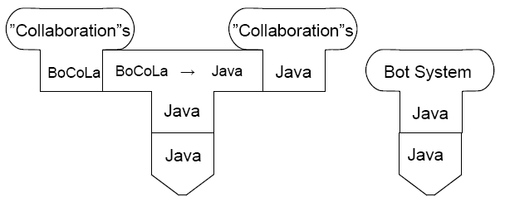
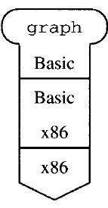
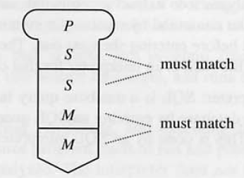
“Tombstones”
Notes:
Here are representation of our system:
BoCoLa source language translated to Java code and Java code used in Java Machine.
Bot System
Examples of the interpreter with basic and x86 machine code. Basic program “graph” is written in Basic language and Basic interpreter is expressed by x86 machine language and executed by x86 machine.
P – program written in S language. S interpreter expressed into M and executed into machine M.

Slide 6
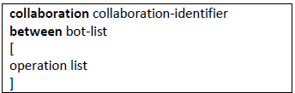
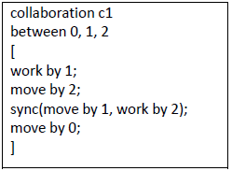
BoCoLa Language Definition
Collaboration abstraction – definition of what should be, reduce (or skip) the information how it is done
Extend BoCoLa with keyword sync:
Semantics: consist of two methods (method could be “work” or “move”), and these methods could be executed by bot(s) n
Contextual constrains: methods could be the same or different as well as bot number n, bot number n should be described in bot list

Slide 7

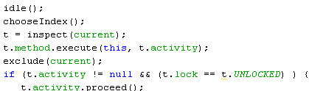

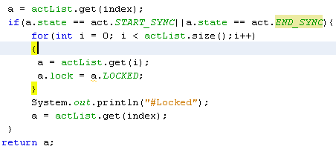
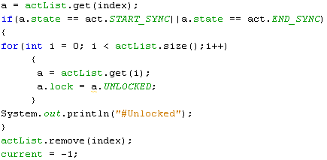
Modification of runtime system
Participant
Activity
Lock
Locked
Unlocked
Notes:
Modified runtime system allow us to execute in right order – synchronize. If in participant list there are synchronized bots when all other participants are locked and they have to wait until synchronized participants finish.
BoCoLa runtime system (Activity, Participant)
Read ( 5.3;6.4.2,6.7-6.8;7.2)
What is runtime system?
Run time system – software collection created to support execution. It provides services: libraries, subroutines for common operations (code generation, debugging, ...)
Why is it necessary?
Because it relief programmer of writing ordinary code. It provides all necessary simple features.
Why BoCoLa need runtime system?
It supports collaborations between bots.
Run time organization?
Into Activity and Participant class. Participant is a bot which doing some of activity (Move or Work). Participants executed from list.

Slide 8
Extension of synchronization
sync
List of participants
Work
Move
null
sync
Move
Work
Move
null

Slide 9
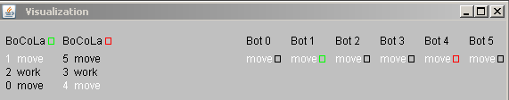
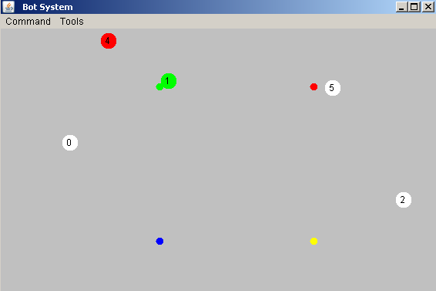
Results
Notes:
Picture of the Bots System runtime. Here are collaborations between bots.
By using the keyword sync it takes longer to execute, because of the wait. During synchronized bot execution no other bots execute. This guarantee right order of bots execution (move or/and work).

Slide 10
Concrete BoCoLa example
(Translation)
BoCoLa
Java
Java
Language | Syntax
BoCoLa | collaboration c1 between 0, 1, 2 [ sync(move by 1, work by 2); move by 0; ] collaboration c2 between 3,4,5 [ move by 5; work by 3; move by 4; ]
Java | Collaborations[No] = new Collaboration(); { Collaborations[No-1].include(new BotMethod.botMove(),Bot.bots[1],new BotMethod.botWork(),Bot.bots[2]); Collaborations[No-1].include(new BotMethod.botMove(),Bot.bots[0]); } Collaborations[No]=new Collaboration(); { Collaborations[No-1].include(new BotMethod.botMove(),Bot.bots[5]); Collaborations[No-1].include(new BotMethod.botWork(),Bot.bots[3]); Collaborations[No-1].include(new BotMethod.botMove(),Bot.bots[4]); }

Slide 11
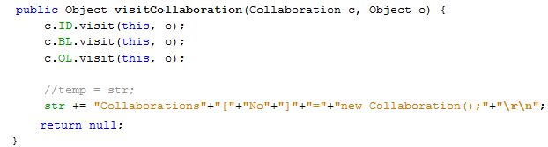

Visitor Pattern and Code Generation
Each tree node has method with parameter of visitor instance
Visitor node has methods with parameters of tree instances
Encoder.java
Generate code from BoCoLa to Java, by using Java
BoCoLa
Java
Java

